Slide 1

Automotive Technology: A Systems Approach, 8e
Chapter 26: Ignition Systems
Rob Thompson and Jack Erjavec, Automotive Technology: A Systems Approach, 8th Edition. © 2025 Cengage. All Rights Reserved. May not be scanned, copied or duplicated, or posted to a publicly accessible website, in whole or in part.

Slide 2
Chapter Objectives
26.01 Name the two major electrical circuits used in all ignition systems and their common components.
26.02 Describe the operation of ignition coils, spark plugs, and ignition cables.
26.03 Describe spark timing systems, including electronic switching systems and their related engine position sensors.
26.04 Name and describe different types of ignition systems.
26.05 Describe the components and operation of distributorless ignition systems.

Slide 3
Basic Circuitry
26.01 Name the two major electrical circuits used in all ignition systems and their common components.
All ignition systems consist of two interconnected electrical circuits:
A primary (low-voltage) circuit and a secondary (high-voltage) circuit.
Components in the primary circuit include the following:
  Battery, ignition switch, ignition coil primary winding, triggering device, switching device, or control module (igniter).
  The secondary circuit includes these components:
    Ignition coil secondary winding, distributor cap and rotor (older systems), high-voltage cables (some systems), spark plugs.

Slide 4
Primary Circuit Operation
When the ignition switch is on, battery voltage is supplied to the positive connection of the primary winding of the ignition coil.
This path to the coil may be through the ignition switch, ignition control module, or PCM depending on the system.
The negative connection of the primary winding is connected to a switching device.
This can be an ignition control module or the PCM.
When the switch is closed, current flows through the circuit.
The current flow through the ignition coil’s primary winding creates a magnetic field.
As the current continues to flow, the magnetic field gets stronger.
When the triggering device signals to the switching unit that the piston is approaching TDC on the compression stroke, the circuit opens and current flow is stopped.
This causes the magnetic field around the primary winding to collapse across the secondary winding.
The movement of the magnetic field across the winding induces a high voltage in the secondary winding.

Slide 5
Secondary Circuit Operation
The secondary circuit carries high voltage to the spark plugs.
The exact manner in which the secondary circuit delivers these high-voltage surges depends on the system.
Until 1984, all ignition systems used some type of distributor to accomplish this job.
However, in an effort to reduce emissions, improve fuel economy, and boost component reliability, auto manufacturers are now using distributorless or electronic ignition (EI) systems.

Slide 6
Ignition Components
26.02 Describe the operation of ignition coils, spark plugs, and ignition cables.
All ignition systems share a number of common components.
Some, such as the battery and ignition switch, perform simple functions.
The battery supplies low-voltage current to the ignition primary circuit.
The current flows when the ignition switch is in the start or run position.
In newer systems and those with push-to-start, the ignition switch input is used to power up the modules and networks.
Power is then supplied to the ignition system.

Slide 7
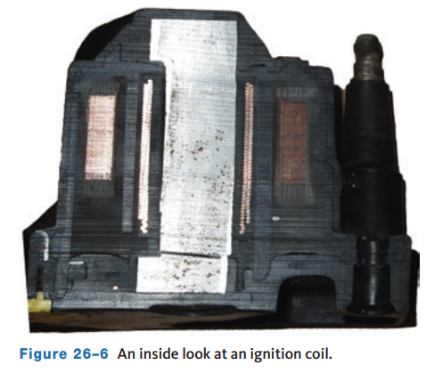
Ignition Coils
The ignition coil is a pulse transformer that transforms battery voltage into short bursts of high voltage.
The trade-off is that the large amount of current flow in the primary circuit is proportionally decreased in the secondary.
The result is the low voltage, and high current flowing through the primary winding is changed into a high voltage, low amperage spark from the secondary.
An ignition coil has two coils of wire wrapped around an iron or steel core.
An iron or steel core is used because it has low inductive reluctance or magnetic resistance.

Slide 8
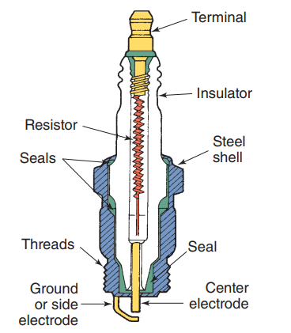
Spark Plugs (1 of 3)
Spark plugs provide the crucial air gap across which the high voltage from the coil causes an arc or spark.
The main parts of a spark plug are a steel shell; a ceramic core or insulator, which acts as a heat conductor; and a pair of electrodes, one insulated in the core and the other grounded on the shell.
The shell holds the ceramic core and electrodes in a gas-tight assembly and has threads for plug installation in the engine.
Current flows through the center of the plug, through a resistor and arcs from the tip of the center electrode to the ground electrode.

Slide 9
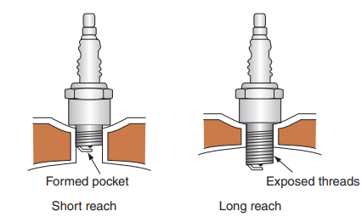
Spark Plugs (2 of 3)
Reach
  This refers to the length of the shell from the contact surface at the seat to the bottom of the shell.
  Reach is crucial because the plug’s air gap must be properly placed in the combustion chamber to produce the correct amount of heat.
  When a plug’s reach is too short, its electrodes are in a pocket and the arc is not able to adequately ignite the mixture.
  If the reach is too long, the exposed plug threads can get so hot they will ignite the air–fuel mixture at the wrong time and cause preignition.

Slide 10
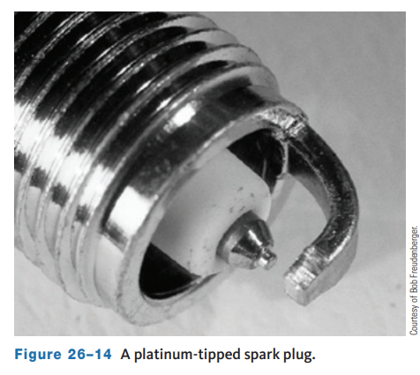
Spark Plugs (3 of 3)
Electrodes
  The materials used in the construction of a spark plug’s electrodes determine the longevity, power, and efficiency of the plug.
  The construction and shape of the tips of the electrodes are also important.
  The electrodes of a standard spark plug are made with copper, and some use a copper-nickel alloy.
  Platinum electrodes are used to extend the life of a plug.

Slide 11
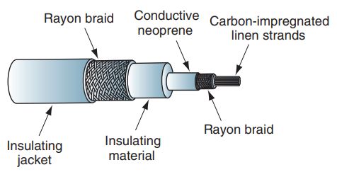
Ignition Cables
Spark plug cables, or ignition cables, make up the secondary wiring.
These cables carry the high voltage from the distributor or the multiple coils to the spark plugs.
The cables are not solid wire; instead, they contain carbon fiber cores that act as resistors in the secondary circuit.
They cut down on radio and television interference, increase firing voltages, and reduce spark plug wear by decreasing current.

Slide 12
Triggering and Switching Devices
Triggering and switching devices are used to ensure the spark occurs at the correct time.
A triggering device is simply a device that monitors the movement of the engine’s crankshaft and pistons.
A switching device is what controls current flow through the primary winding.
When the triggering device sends a signal to the switching device that the piston of a particular cylinder is on the compression stroke, the switching device stops current flow to the primary winding.
This interruption of current flow happens when the PCM decides it is best to fire the spark plug.
Electronic switching components are normally located in an ignition control module, which may be part of the vehicle’s PCM.
On older vehicles, the ignition module may be built into the distributor or mounted in the engine compartment.

Slide 13
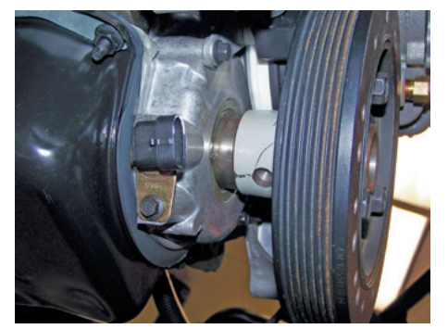
Engine Position Sensors
26.03 Describe spark timing systems, including electronic switching systems and their related engine position sensors.
A number of different types of sensors are used to monitor the position of the crankshaft and control the flow of current to the base of the transistor.
These engine position sensors and generators serve as triggering devices and include magnetic pulse generators, metal detection sensors, Hall-effect sensors, magnetoresistive sensors, and photoelectric (optical) sensors.
These sensors can be located inside the distributor or mounted on the outside of the engine to monitor crankshaft position (CKP).

Slide 14
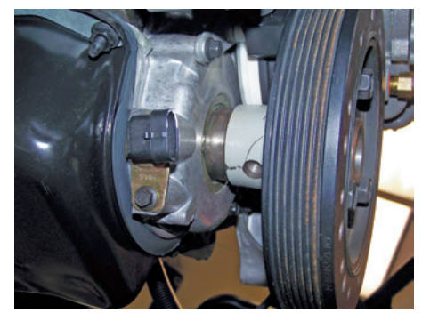
Magnetic Pulse Generator
Basically, a magnetic pulse generator or inductance sensor consists of two parts: a trigger wheel and a pickup coil. The trigger wheel may also be called a reluctor, pulse ring, armature, or timing core.
The pickup coil, which consists of a length of wire wound around a permanent magnet, may also be called a stator, sensor, or pole piece.
Depending on the type of ignition system used, the timing disc may be mounted on the distributor shaft, at the rear of the crankshaft, or behind the crankshaft vibration damper.
The magnetic pulse or PM generator operates on the principles of electromagnetism.

Slide 15
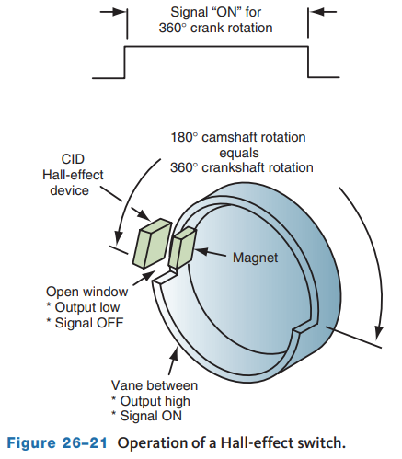
Hall-Effect Sensor
The Hall-effect sensor or switch is the most commonly used engine position (CKP) sensor.
It produces an accurate voltage signal throughout the entire speed range of an engine. It also produces a square wave signal that is more compatible with computers.
In an ignition system, the shutter blades or toothed timing wheel is mounted on the distributor shaft, flywheel, crankshaft pulley, or cam gear so the sensor can generate a position signal as the crankshaft rotates.
A Hall-effect sensor may be normally on or off depending on the system and its circuitry.

Slide 16
Knowledge Check (1 of 2)
What type of waveform does a Hall-effect sensor produce?

Slide 17
Knowledge Check Answer (1 of 2)
  Answer: It produces an accurate voltage signal throughout the entire speed range of an engine. It also produces a square wave signal that is more compatible with computers.

Slide 18
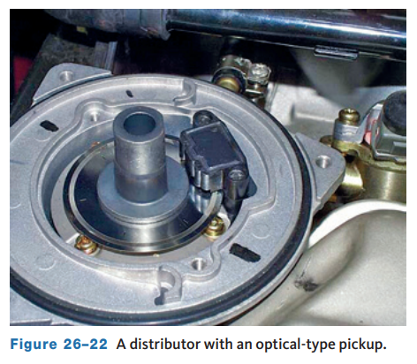
Photoelectric Sensor
Some distributor ignition systems relied on photoelectric sensors to monitor engine position.
These sensors are also called optical sensors.
They consisted of an LED, a light-sensitive phototransistor (photo cell), and a slotted disc called an interrupter.
As the interrupter rotated between the LED and the photo cell, a square wave voltage signal was generated in the photo cell.
Photoelectric sensors may combine both the CKP and CMP sensors together, using one interrupter ring and two sets of LEDs and photo cells.

Slide 19
Distributor Ignition System Operation (1 of 2)
26.04 Name and describe different types of ignition systems.
The primary circuit of a DI system is controlled by a triggering device and a switching device located inside the distributor or external to it.
Although these systems are no longer used by auto makers, there are many of them still on the road and they need service.

Slide 20
Distributor Ignition System Operation (2 of 2)
Distributor
  The reluctor, or trigger wheel, and distributor shaft assembly are attached to a drive gear that is driven by the engine’s camshaft.
  The distributor shaft turns at the same speed as the camshaft, which rotates at one-half the speed of the crankshaft.
  Through the years, there have been many different designs of DI systems.
  All operate in basically the same way: A position sensor sends a signal to an ignition control module.
  The module controls current flow through the coil and opens the secondary circuit to release the spark.

Slide 21
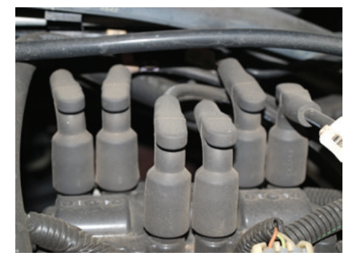
Electronic Ignition Systems
Modern engines are not equipped with a distributor; rather they have electronic ignitions.
In the past, the term electronic ignition was designated to those ignition systems that used electronic controls.
Today, electronic ignitions are those that do not use a distributor.
As distributors were phased out, manufacturers used a waste spark system, where a coil fired two cylinders at the same time.
Modern vehicles use coil-per-cylinder systems.
Most waste spark systems use an ignition module to control firing order while the PCM determines spark timing.

Slide 22
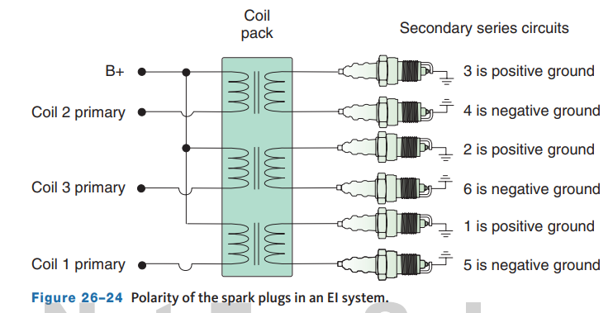
Double-Ended Coil or Waste Spark Systems
Double-ended or waste spark ignition systems use one ignition coil for two spark plugs.
Both ends of the coil’s secondary side are directly connected to a spark plug, which means that two plugs are ignited at the same time; one is fired on the compression stroke of one cylinder and the other is fired on the exhaust stroke of the companion cylinder.
A four-cylinder engine has two ignition coils, a six-cylinder has three, and an eight-cylinder has four.
The computer, ignition module, and various sensors combine to control spark timing.

Slide 23
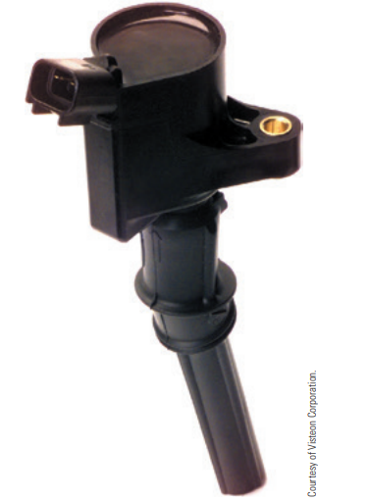
Coil-per-Cylinder Ignition
The operation of a coil-per-cylinder ignition system is basically the same as any other ignition system.
By definition, these systems have an individual coil for each spark plug.
There are two different designs of coil-per-cylinder systems used today: the coil-over-plug (COP) and the separate coil.
COP systems rely on a single assembly of an ignition coil and spark plug.
In these systems, the spark plug is directly attached to the coil, and there is no spark plug wire.

Slide 24
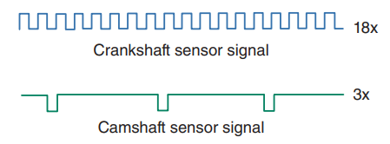
Hall-Effect Sensors
Many Hall-effect sensors rely on pulleys or harmonic balancers with interrupter rings or shutters.
In many cases, the crankshaft pulley has half as many windows as the engine has cylinders.
As the crankshaft rotates and the interrupter passes in and out of the Hall-effect switch, the switch turns the module reference voltage on and off.
The signals are identical and the control module cannot distinguish which of these signals to assign to a particular coil.
Many CMP sensors are Hall-effect sensors and produce a square wave signal.

Slide 25
Discussion
Coil on plug type ignition systems have become the most common.
Have a class discussion on the positives and negatives of this type of ignition system.

Slide 26
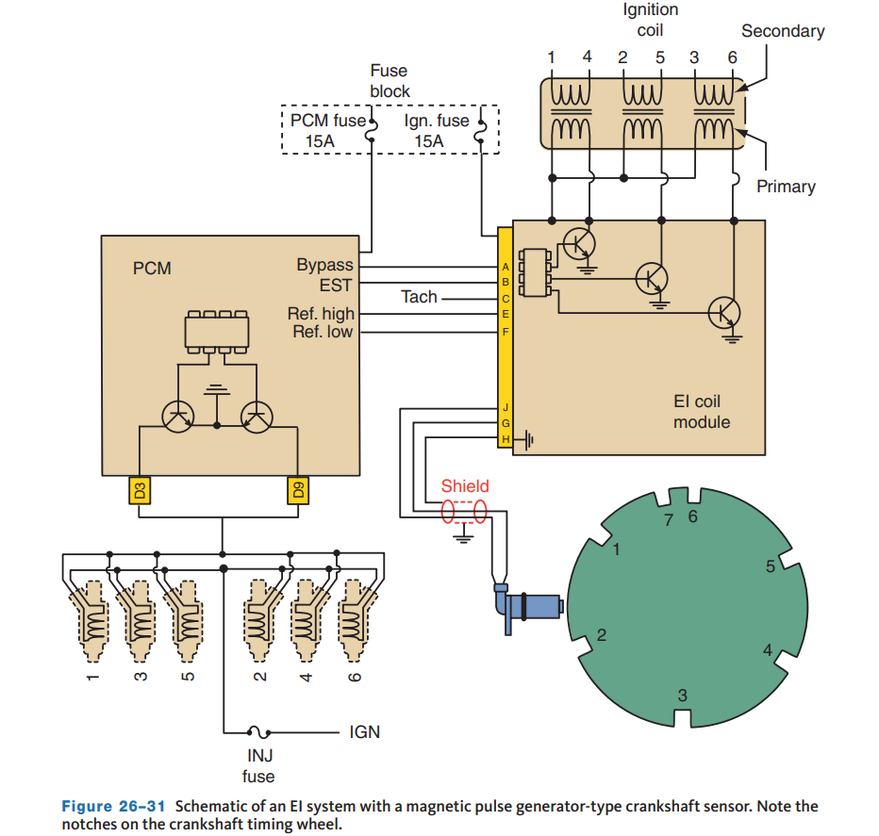
Magnetic Pulse Generators
Many late-model engines use magnetic pulse generators as CKP sensors.
The trigger wheel, also called the reluctor, can be located behind the crankshaft pulley, inside the engine in the middle of the crankshaft, or at the flywheel.
The design of the trigger wheel depends on the application and operation of the system.
In more basic systems, the trigger wheel is located behind the crankshaft pulley.

Slide 27
Magnetoresistive Sensors
This type of sensor is used as a CKP sensor and is usually mounted behind the crankshaft pulley or is bolted to the block.
A toothed timing wheel may be mounted on the end of the crankshaft, integrated into the crankshaft, or located on the flywheel.
MR sensors produce a digital square wave pattern that increases in frequency as engine speed increases.

Slide 28
Misfire Detection
A high data rate CKP sensor is used to detect engine misfires, required for OBD II, and the CMP is used to identify which cylinder is misfiring.
Misfires are detected by variations in crankshaft rotational speed for each cylinder.
An interesting feature of most misfire monitors is the ability of the PCM to distinguish an actual misfire from other things that may cause the engine’s speed to fluctuate.
Driving on a rough road can cause the vehicle’s wheels to change rotational speed; this in turn will affect the rotational speed of the crankshaft.
To determine whether the engine has misfired or the vehicle is merely driving on a poor surface, the PCM receives wheel speed data from the antilock brake system.
A rough road will cause variances in wheel speed, and the PCM looks at that data before concluding a misfire occurred.

Slide 29
Basic Timing
The PCM totally controls ignition timing, and ignition timing is not adjustable.
When the engine is cranked for starting, the PCM sets the timing at a fixed value.
This value is used until the engine is running at a predetermined speed.
Once that speed is met, the PCM looks at several inputs, including engine speed, load, throttle position, and engine coolant temperature, and makes adjustments accordingly.
The PCM continues to rely on those inputs and its programmed strategy throughout operation.
All PCMs have limits as to how far the timing can be retarded and advanced.

Slide 30
Knowledge Check (2 of 2)
On a modern computer controlled vehicle, what controls ignition timing and how it is adjusted by the technician?

Slide 31
Knowledge Check Answer (2 of 2)
The PCM totally controls ignition timing, and ignition timing is not adjustable.

Slide 32
Chapter Reflection
Please take a moment to compare your ignition systems after you studied this chapter. Then respond to the following questions in one or two paragraphs. Use 150–200 words in your reflection.
Did you find anything in the chapter difficult to understand? How will you improve your understanding?
Considering all you have learned, do you feel you are ready to diagnose ignition system concerns in a shop or lab setting? How can you be more prepared?

